Slide 1
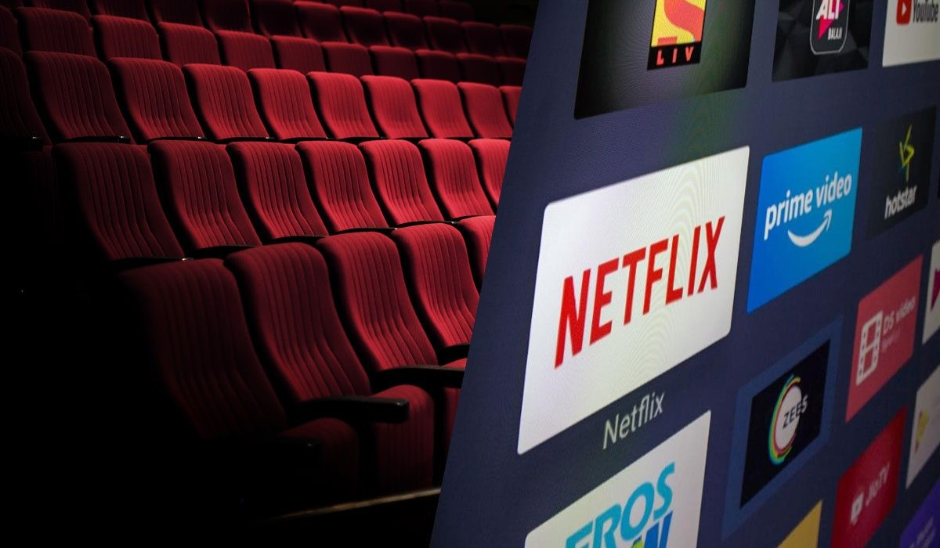
Streaming Wars: Are Streaming Platforms Killing the Movie Theater Experience?
Sriram Chunduri

Slide 2
Introduction
The COVID-19 pandemic accelerated the shift toward hybrid film release models combining theater and streaming.
The decline of theaters could negatively impact local economies by reducing jobs and surrounding business activity.
Streaming platforms like Netflix and Disney+ have transformed content consumption, becoming the primary medium over traditional theaters.
The future of entertainment distribution may require balancing streaming innovations with preserving traditional cinematic experiences.
jobs and surrounding business activity.

Slide 3
Research Goals
Analyze viewer reviews to uncover opinions on:
Accessibility of content
Economic impacts
Artistic quality and value
Future of cinema
Discovery Focus:
How streaming and theaters coexist and compete.
How viewer sentiments shape the entertainment landscape.
Beneficiaries:
Streaming platforms
Movie theaters
Content creators
Marketing and strategy teams

Slide 4
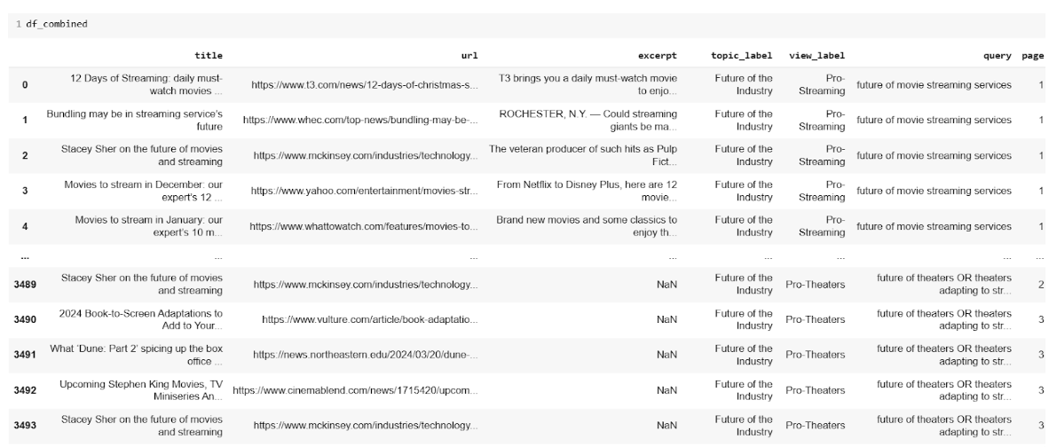
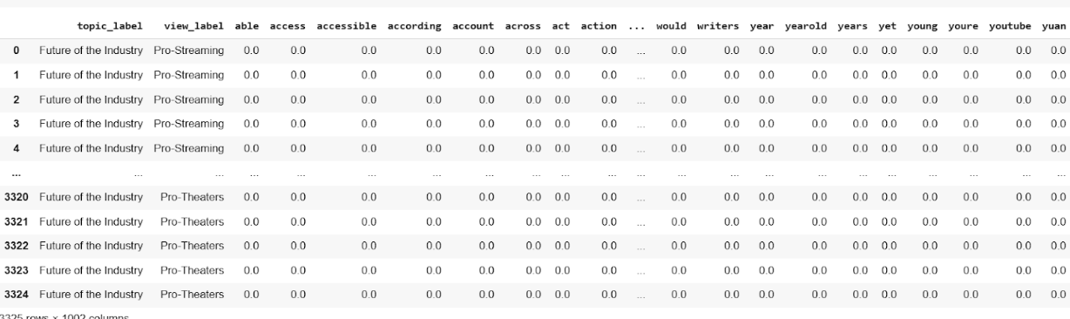
Raw & Cleaned Data
Data Cleaning Steps
Special and Single Character Removal
Stop Words Removal
Punctuations and Extra Space Removal
Tokenization
Stemming
Lemmatization
Count Vectorization
TF-IDF Vectorization

Slide 5
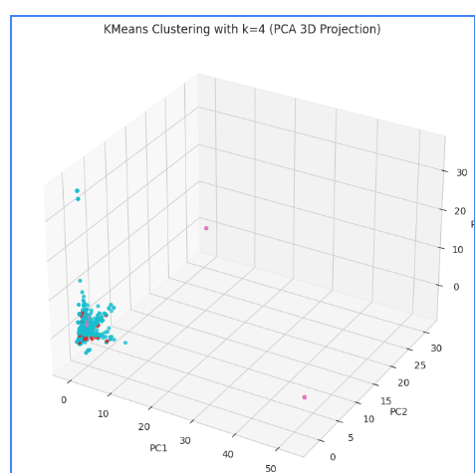
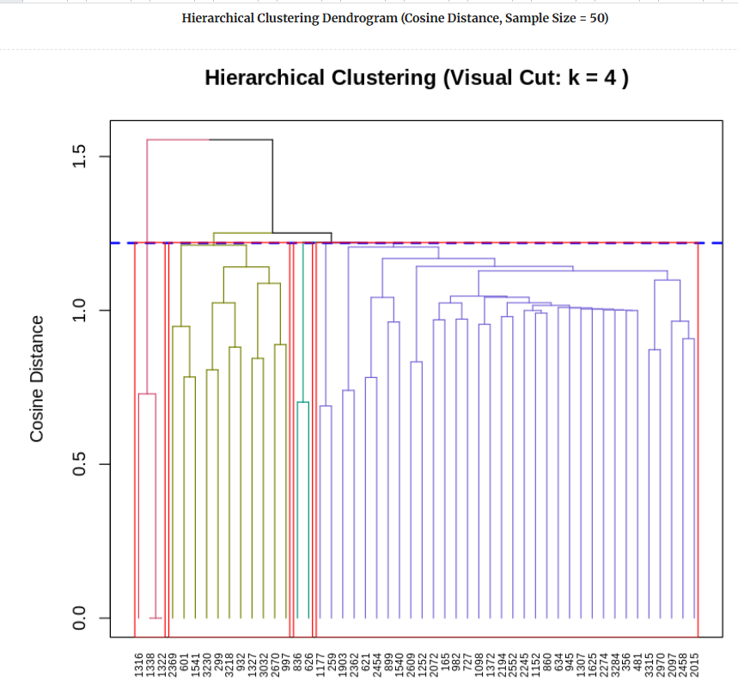
Key Insights of K-Means Clustering
Silhouette and Elbow methods confirmed k=4 as optimal for strong cluster separation.
3D PCA visualization validated clear clustering with minimal outliers.
Hierarchical clustering also supported k=4, showing deeper nested structures.
K-Means offered fast assignments, while Hierarchical revealed deeper insights.

Slide 6
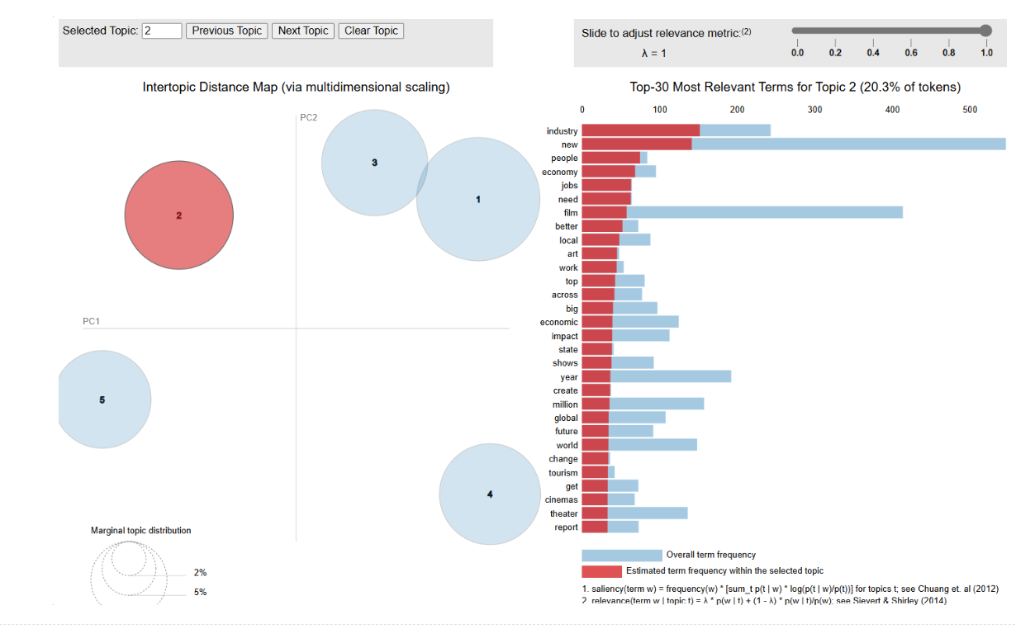
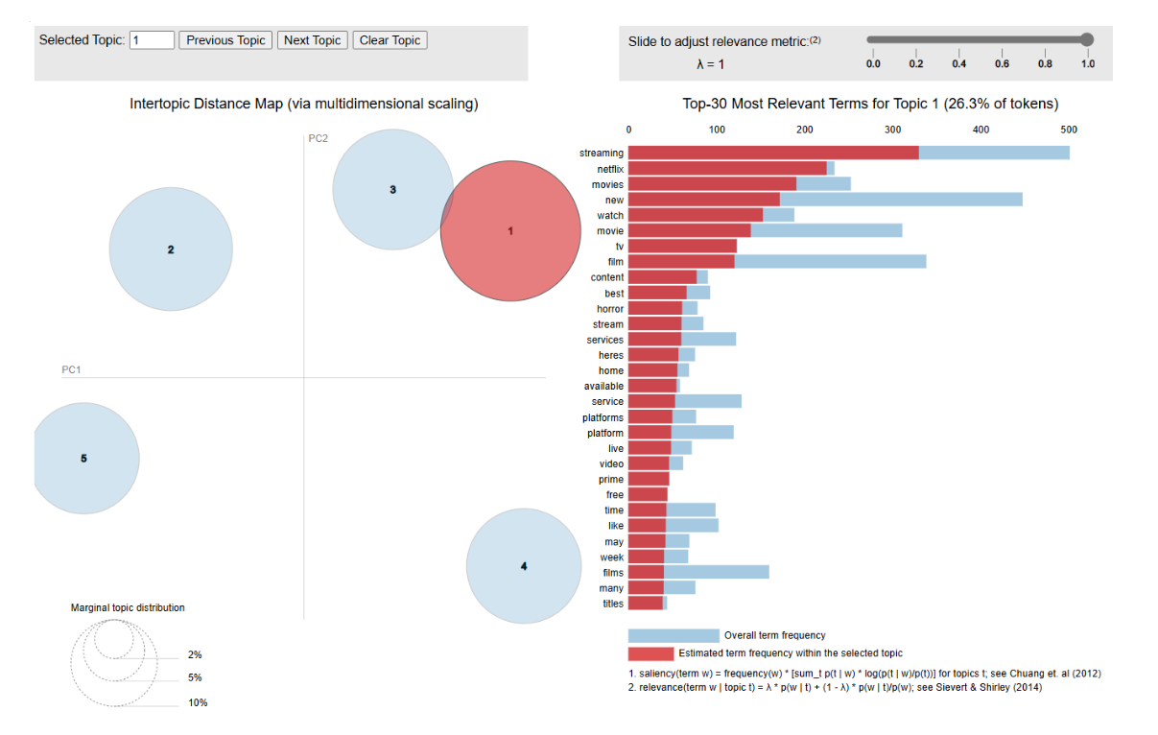
About LDA
Five major topics identified: business, society, streaming, and theater innovation.
Topics 1 & 4 show shift from traditional box office to digital streaming.
Topics 2 & 3 highlight economic and social impacts, including AI and job creation.
Topic 5 focuses on evolving theater experiences using new technologies.

Slide 7
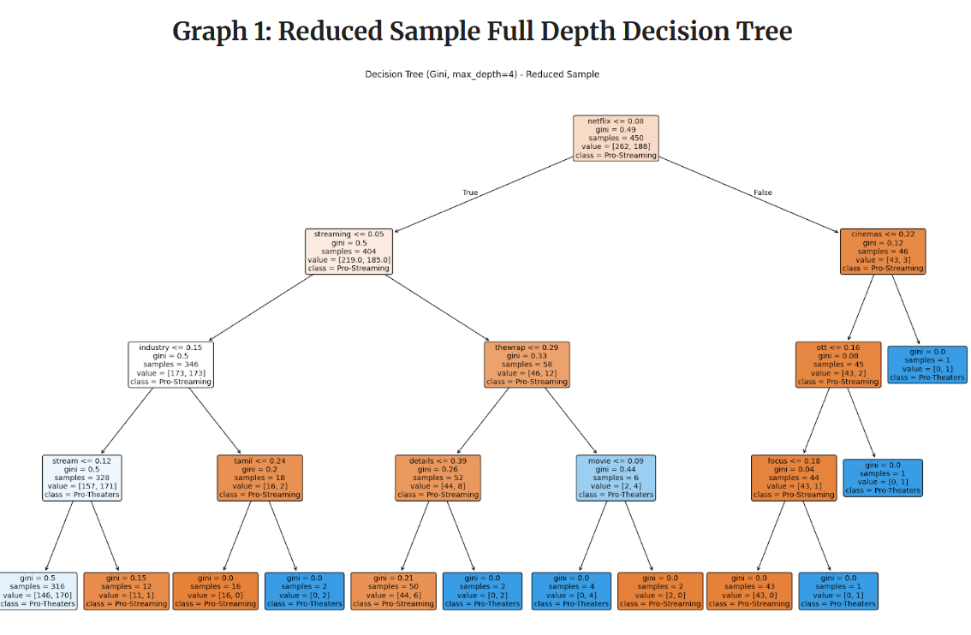
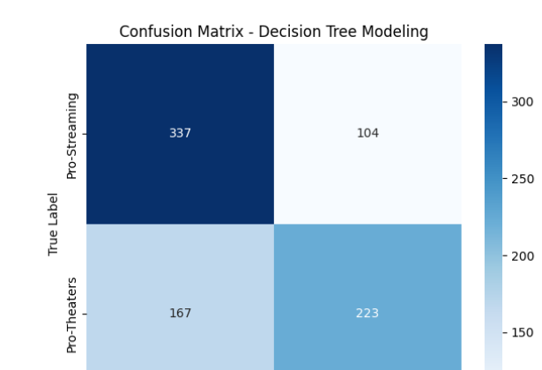
Key Insights of Decision Trees
"Streaming," "Netflix," and "industry" were key TF-IDF predictors across all trees.
Full-depth trees captured fine language variations to predict Pro-Streaming or Pro-Theaters.
Gini-based depth-4 tree balanced performance and interpretability well.
Confusion matrix showed 67% accuracy, slightly favoring Pro-Streaming predictions.

Slide 8
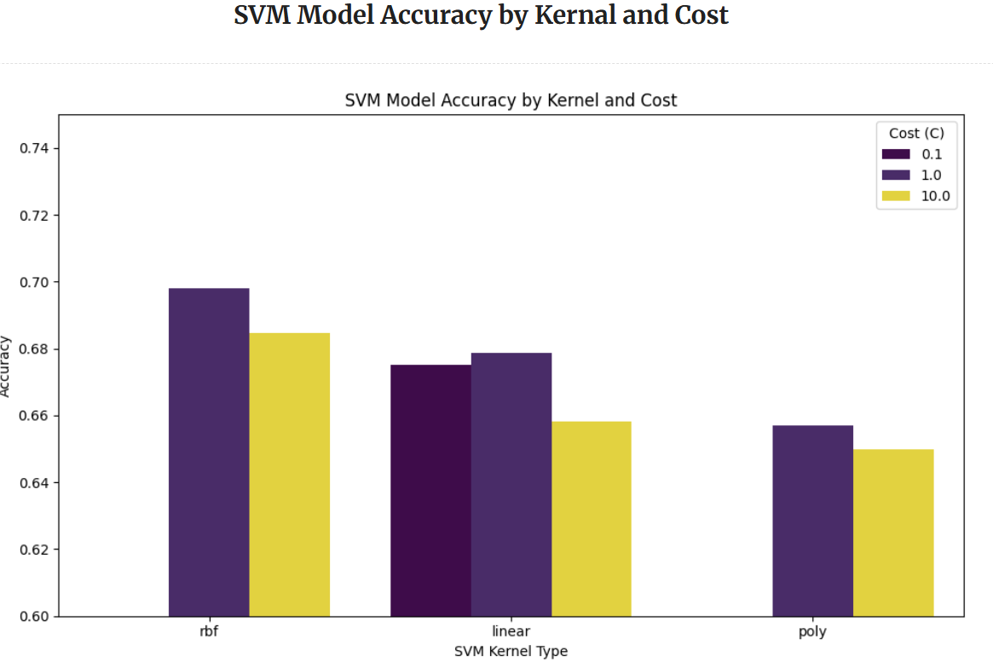
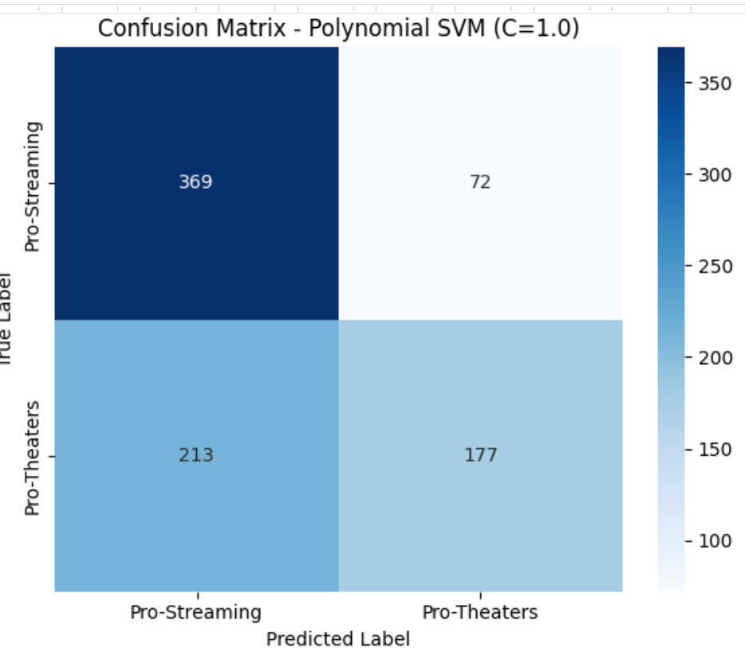
About Support Vector Machines
RBF kernel (C=1.0) achieved highest accuracy (~70%), outperforming linear and polynomial kernels.
SVM with RBF significantly outperformed baselines like Naïve Bayes for complex text classification
Confusion matrix showed balanced classification with low false negatives for both classes.
Kernel and cost tuning were critical, with RBF best handling non-linear, high-dimensional TF-IDF data..

Slide 9
Final Thoughts
Streaming and theaters represent two evolving but interconnected models in entertainment.
Clustering and LDA revealed clear thematic divisions around business, society, streaming habits, and innovation.
Decision Trees highlighted key predictive terms like "streaming" and "netflix" for sentiment classification.
SVM models (especially RBF) achieved the best performance for classifying editorial opinions.
Combining clustering, topic modeling, and classification provided a deep, multi-angle understanding of the debate.

Slide 10


